Slide 1
Why Hackers Keep Winning
@AWSMHACKS

Slide 2
Depth Security
If there is a way in, we’ll find it.
Who we are
A boutique information security firm founded in 2006 and based in Kansas City.
What we do
Offense: Identify and exploit weaknesses in networks and applications
Defense: Help defend against real-world threats utilizing services and solutions
Our clients
We work with a wide range of clients from small and medium-sized businesses to the Fortune 500.

Slide 3
Let’s Talk About It
Outline
Breach Lyfe
Pentesting 101
Entry Points
Attacking Users

Slide 4
“You have to assume you've been breached.”
-Brad Anderson , Microsoft CVP
“There are 2 types of companies in our world.
Those that have been hacked, and those that don’t know they have been hacked”
-Robert Mueller
Notes:
In order to effectively defend ourselves we need to understand how attacks occur.

Slide 5
2017 Breaches
Highlights
January 8, 2017 E-Sports Entertainment Association
February 1, 2017 Xbox 360 ISO and PSP ISO
February 7, 2017 InterContinental Hotels Group
February 17, 2017 Arby’s
March 6, 2017 River City Media
March 7, 2017 Verifone
March 15, 2017 Dun & Bradstreet
March 19, 2017 Saks Fifth Avenue
March 20, 2017 UNC Health Care
March 21, 2017 America’s JobLink
April 6, 2017 FAFSA: IRS Data Retrieval Tool
April 25, 2017 Chipotle
May 2, 2017 Sabre Hospitality Solutions
May 10, 2017 Bronx Lebanon Hospital Center
May 12, 2017 Brooks Brothers
May 17, 2017 DocuSign
May 31, 2017 OneLogin
May 31, 2017 Kmart
June 27, 2017 Anthem
July 13, 2017 Verizon
September 7, 2017 Equifax
September 21, 2017 U.S. Securities and Exchange Commission
September 25, 2017 Deloitte
September 26, 2017 Sonic
October 6, 2017 Disqus
October 9, 2017 Yahoo! (Update)
October 12, 2017 Hyatt Hotels
November 14, 2017 Maine Foster Care
November 14, 2017 Forever 21
November 21, 2017 Uber
November 24, 2017 Imgur
December 1, 2017 TIO Networks

Slide 6
2018 Breaches
Just Looking at March
March 27, 2018 JC Penny
March 29, 2018 MyFitnessPal / UnderArmor
March 26, 2018 Mississippi State Dept.
March 26, 2018 Prudential Insurance
March 26, 2018 Paycor
March 28, 2018 Shutterfly
March 23, 2018 Oregon Dept of Revenue
March 15, 2018 UnitedHealth Group Single Affiliated Covered Entity
March 23, 2018 City of Atlanta
March 20, 2018 Community First Bank
March 15, 2018 Orbitz
March 6, 2018 Citizens Financial Group
March 17, 2018 Frost Bank
March 18, 2018 Primary Health Care Inc.
March 12, 2018 University of Pennsylvania
March 13, 2018 Barnes-Jewish Healthcare
March 1, 2018 Beachbody, LLC
March 3, 2018 Kansas Department for Aging and Disability Services
~ 945 This year!
Hackers Keep Winning
https://breachlevelindex.com/
https://www.idtheftcenter.org/images/breach/2018/ITRCBreachReport2018.pdf
Notes:
End-Hackers Keep Winning

Slide 7

Defensive Toolset Evolution
Defender’s taking notice
AV is Dead, NEXT-GEN AV THOUGH!!
Started looking at execution vs File Scanning
The new kids in town
Compromise Detection, Investigative, Response capable
Microsoft Gets it (if you can afford it that is)
CredentialGuard | AppGuard | NetworkGuard SystemGuard | ExploitGuard | DeviceGuard AccountGuard | Firewall w/Advanced Security?
Behavior Based Defenses
-Advanced Threat Analytics
-”Smart” Firewalls
Deception Technologies
https://www.idtheftcenter.org/images/breach/2018/ITRCBreachReport2018.pdf

Slide 8
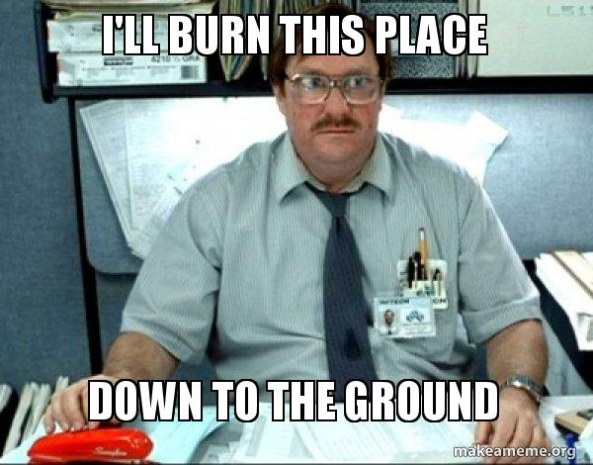
Defensive Products Won’t Stop Everything
Who needs vulnerabilities?
Weak Passwords
3rd party vendor breaches
Default Configurations
Disgruntled Employees
Accidental Exposure
https://www.idtheftcenter.org/images/breach/2018/ITRCBreachReport2018.pdf
Notes:
So we get pentest

Slide 9
Types of Pentest
“I want a pentest”
External
Vuln, Pen, Vuln/Pen, Shields Up, Shields Down
Internal
Vuln, Pen, Vuln/Pen, Shields Up, Shields Down, Contractor Access
Red Team
Purple Team / Adversary Simulation
Application Assessment
Mobile Assessment
Wireless Assessment
Audits

Slide 10
Whats a Pentest?
Basic Steps
Generic Pentest:
Pre-engagement Interactions (scoping)
Intelligence Gathering (Recon)
Vulnerability Analysis (Scanning)
Exploitation
Post Exploitation
Reporting
https://www.idtheftcenter.org/images/breach/2018/ITRCBreachReport2018.pdf

Slide 11
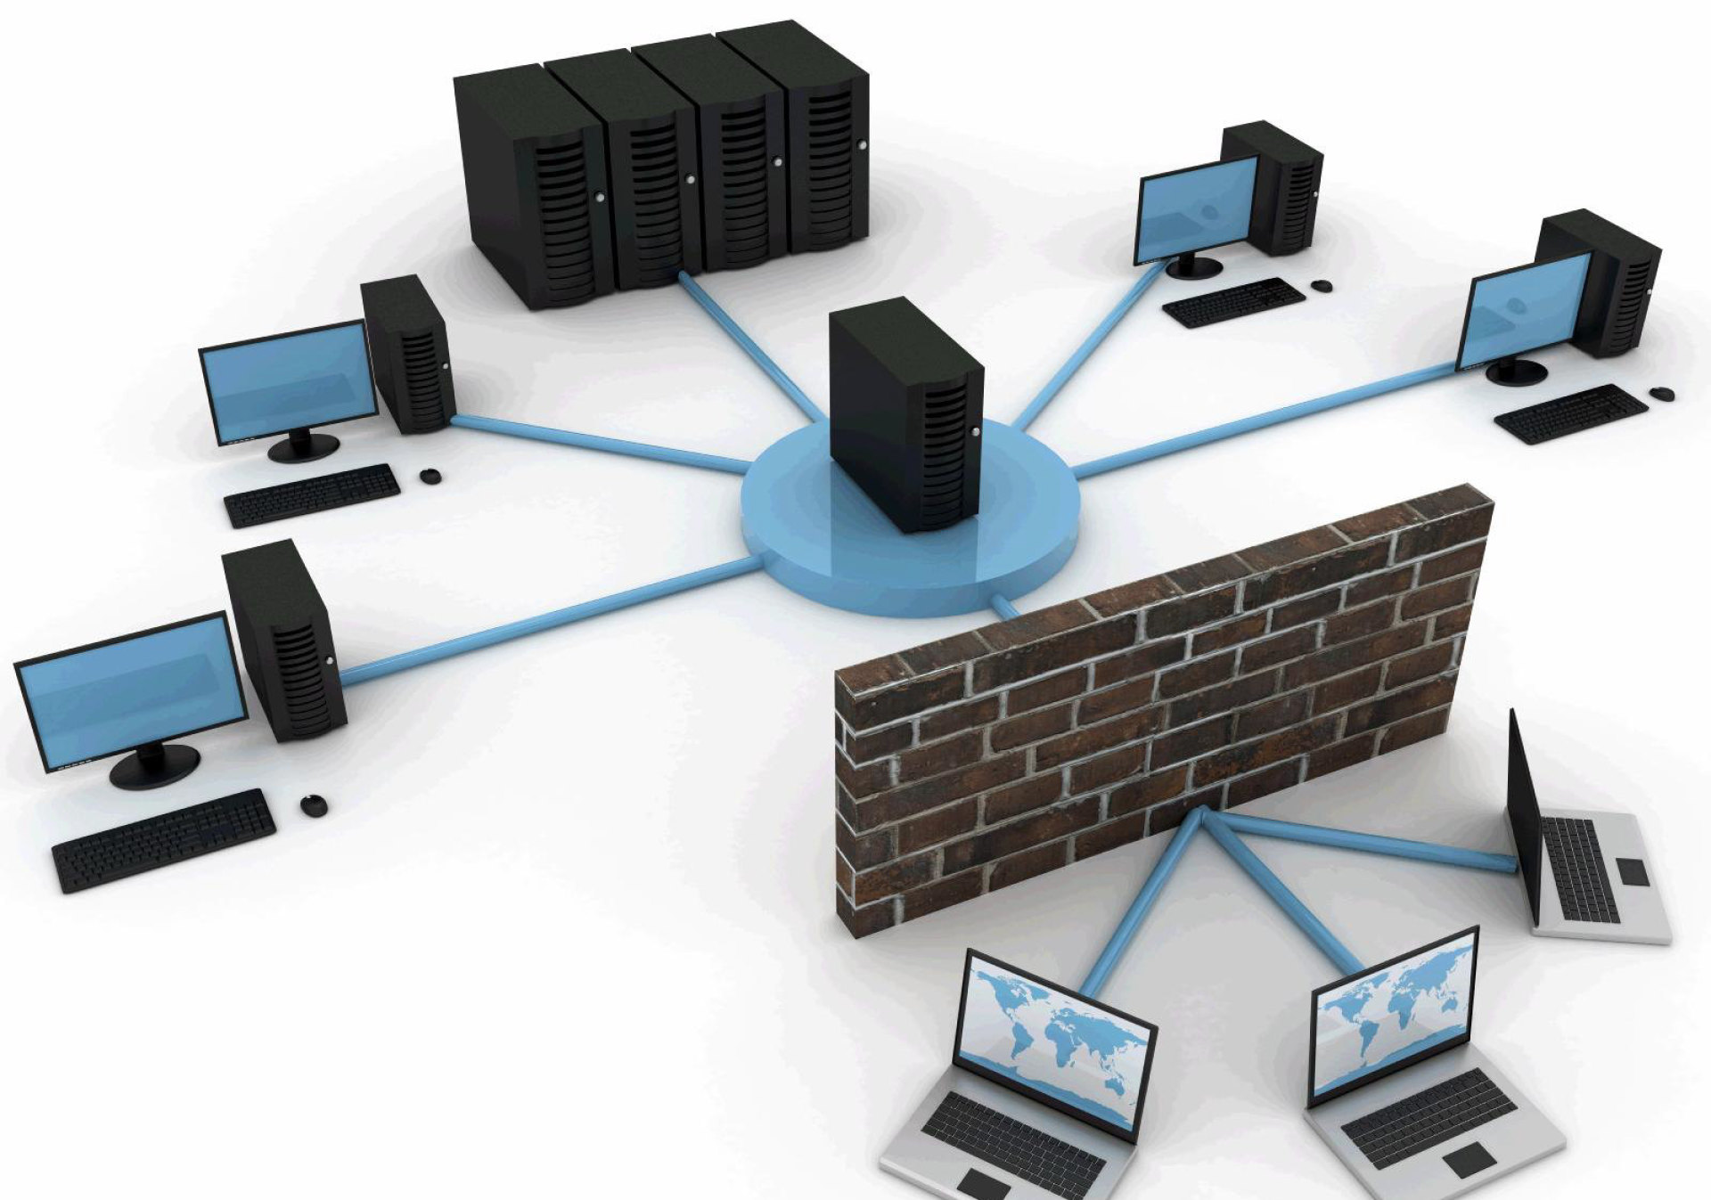
General Attack Strategy
Enumerate the external network
Break in
Enumerate the internal network
Move around network to access moar data/creds/privileges

Slide 12
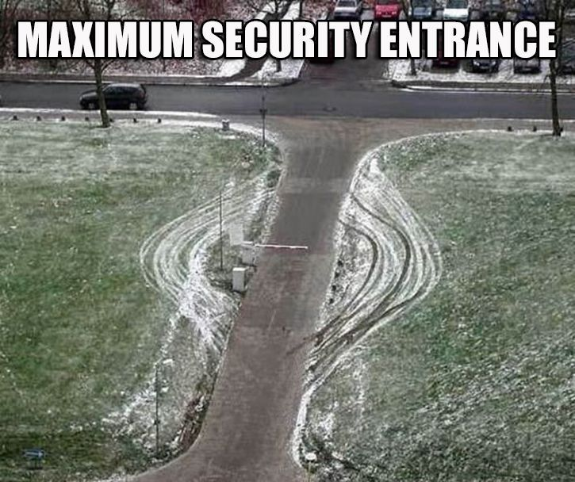
Entry Points
Enter Here, or Here, or Here, or Here, or Here, or Here
Vulnerabilities!
Users
Phishing
Opening up holes
Posting info on accident
Login Points
Citrix
OWA
VPN’s

Slide 13

Entry Points
Who’s Attacking Us?
Bots and Cyber Criminals
Motivated Attackers
Activist
‘Freedom’ Fighters
Anarchist
The Almighty ATP
Governments
Corporate/Political Espionage
-
← Vulnerabilities!
← Users
← Login Points

Slide 14
Attacks on Users
#LetMeIn
Weak Credentials
Poor Credential Management
Opening Documents
USB Drives

Slide 15
Attacks on Users
Won’t you be my friend?
Password Spraying in 2018
Gather List of Accounts

Slide 16
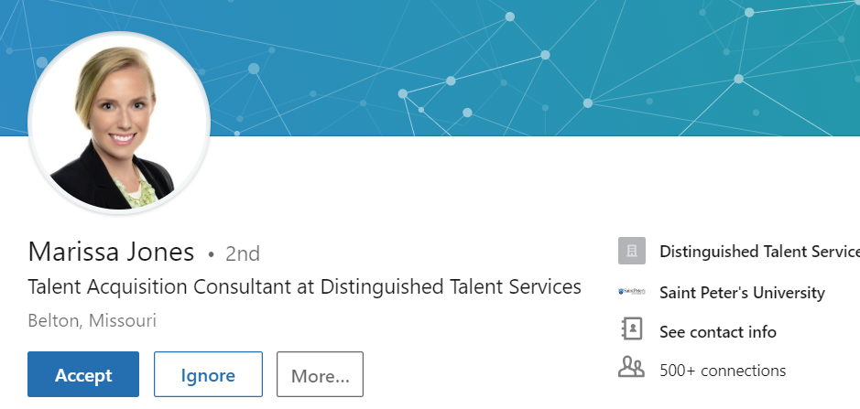
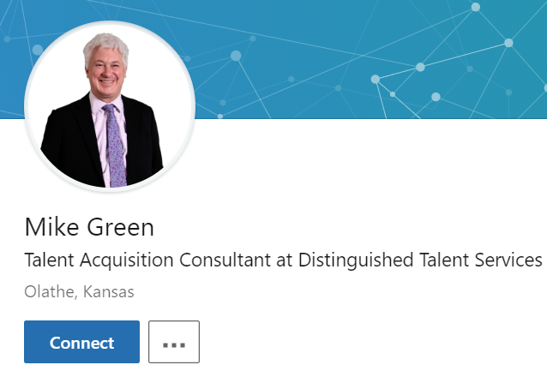
Attacks on Users
Won’t you be my friend?
Password Spraying in 2018
Gather List of Accounts

Slide 17
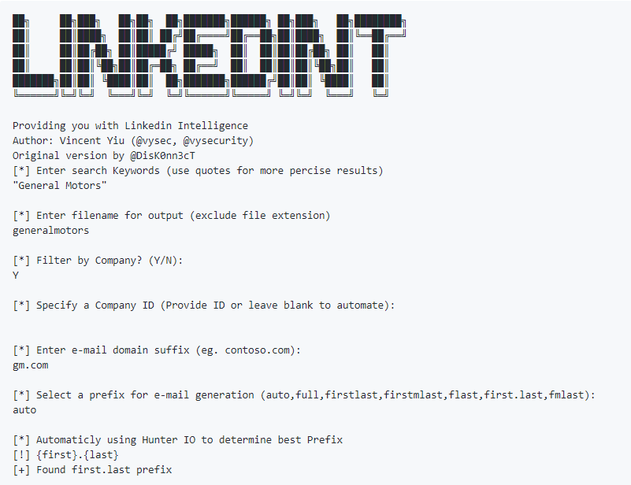
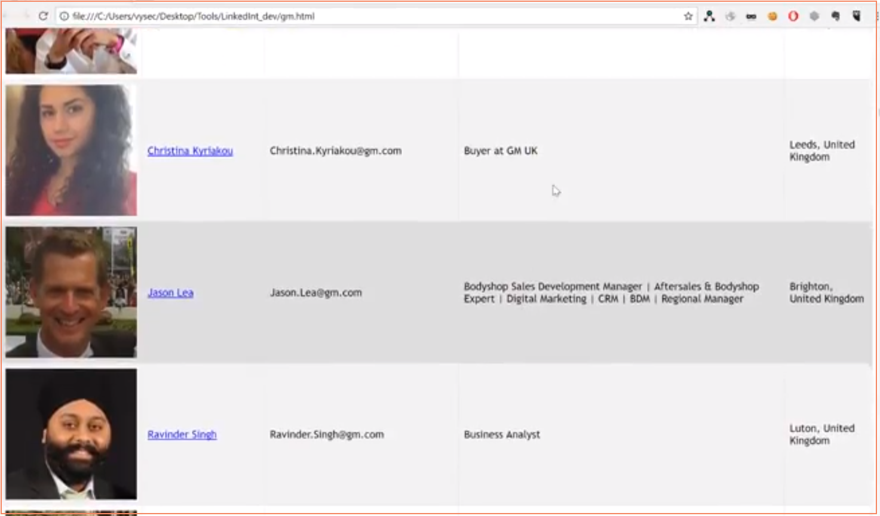
Attacks on Users
Won’t you be my friend?
Password Spraying in 2018
Gather List of Accounts

Slide 18
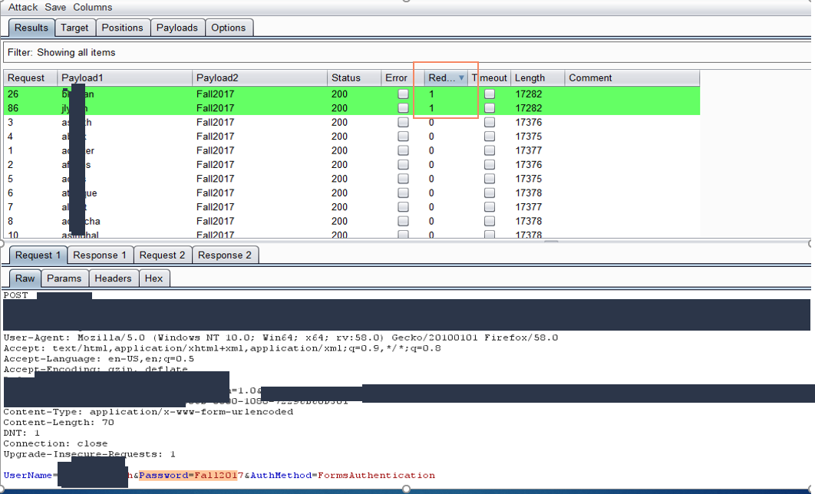
Attacks on Users
Weak Credentials
Password Spraying in 2018
Gather List of Accounts
Attempt a Single Password

Slide 19

Attacks on Users
Weak Credentials
Password Spraying in 2018
Gather List of Accounts
Attempt a Single Password
Use any type of Access to Gather More Accounts

Slide 20
Attacks on Users
Weak Credentials
Password Spraying in 2018
Gather List of Accounts
Attempt a Single Password
Use any type of Access to Gather More Accounts
Spray Again

Slide 21
Attacks on Users
Defending against Password Spraying
Multi-Factor Protected Logins
*Can be done incorrectly
Force the Enrollment! Possibly Restrict to IP
Push vs Pin-Code vs SMS
Use phrases or your favorite password twice
Reduce the need for 90/120/365 day changes

Slide 22
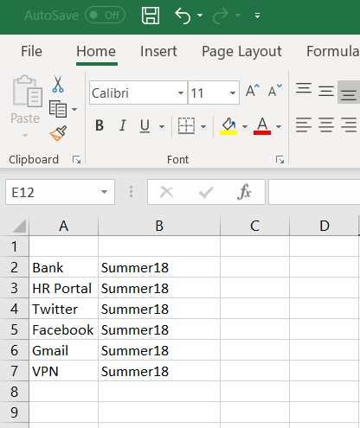
Attacks on Users
Poor Credential Management
Passwords.xls (.txt) (.csv) (.doc)
Watch your internal shares!
Password Reuse across sites
Learn Password Managers

Slide 23
Attacks on Users
Poor Credential Management
Passwords.xls (.txt) (.csv) (.doc)
Watch your internal shares!
Password Reuse across sites
Learn Password Managers

Slide 24
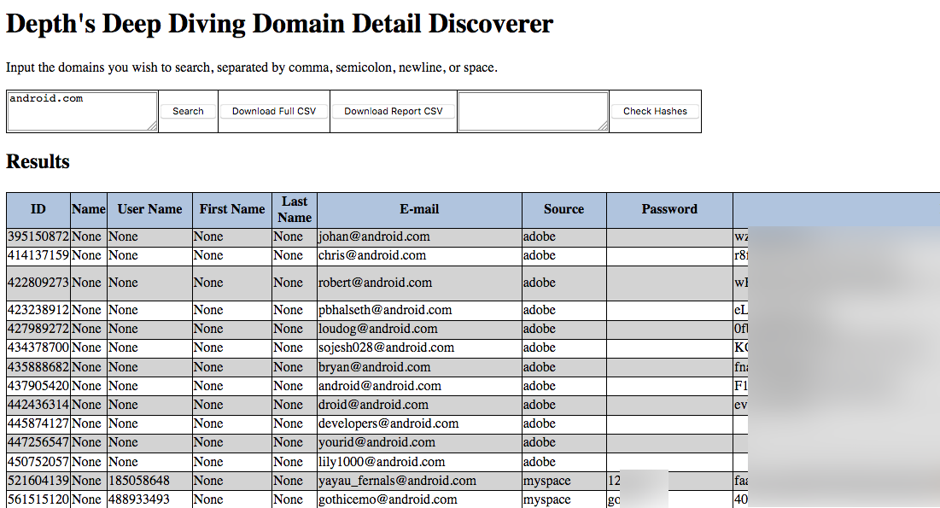
Attacks on Users
Poor Credential Management

Slide 25
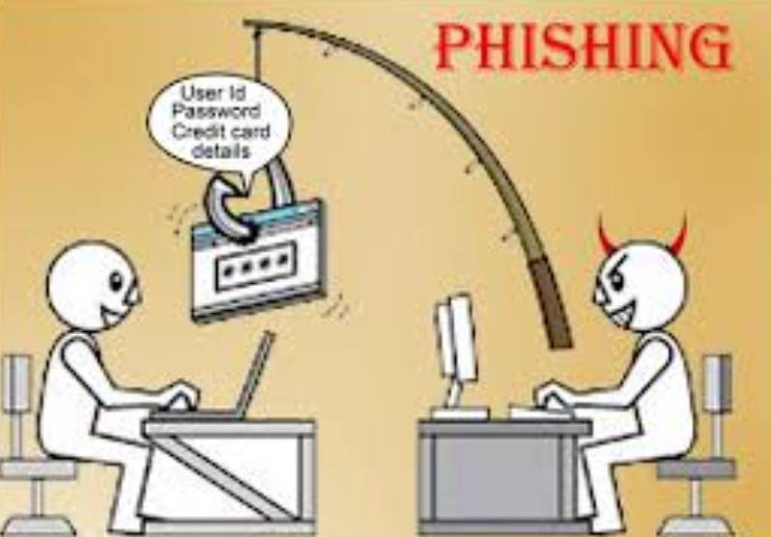
Attacks on Users
Opening Documents
“Teach a man to phish and he will have access for life”

Slide 26
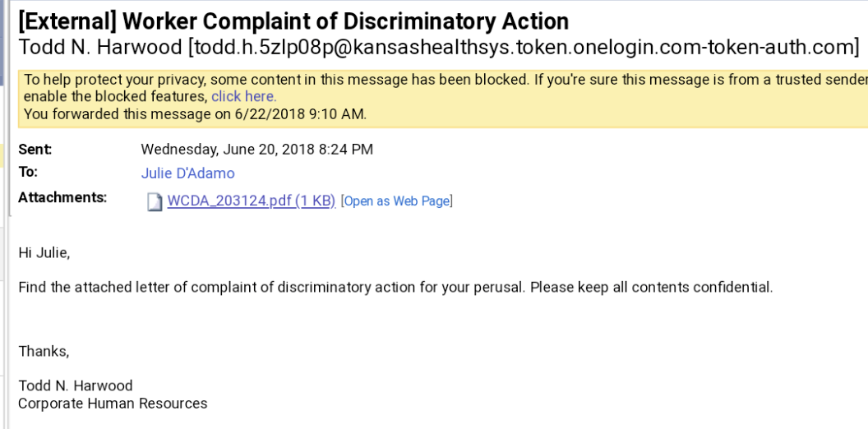
Attacks on Users
Opening Documents
Scenario - HR violation.
HR.AlmostYourCompanysDomain.COM

Slide 27
Attacks on Users
Fighting Phishing
Phish your users!
If you think you may have been phished, Speak Up!
User Awareness Programs

Slide 28

Attacks on Users
You’re a Bad USB, Bad!
BITCOINS HERE!
RubberDucky by Hak5
USBHarpoon
BadUSB
USB-Killer

Slide 29
Attacks on Users
You’re a Bad USB, Bad!
BITCOINS HERE!
RubberDucky by Hak5
USBHarpoon
BadUSB
USB-Killer
Disable Autorun

Slide 30
You’ve Been Compromised
They have creds
Any of the initial attack methods provide the attacker with some credentials
Identify Users and Email Addresses = Logins to Citrix/VPNs
Harvesting Metadata = Logins to Citrix/VPNs
RCE - Vulnerabilities = Creds

Slide 31

Attacking The Network
Theory
Bob
Alice
Desktop2
SqlAdmins
Desktop1
John
Joe
Mary
DA Steve
SQLServer
WebServer

Slide 32
Attacking The Network
Ohhh Bob, Bob’s Compromised
Bob
Alice
Desktop2
SqlAdmins
Desktop1
John
Joe
Mary
DA Steve
SQLServer
WebServer

Slide 33
Attacking The Network
Bob’s Has Local Admin on Desktop 1 and 2
Bob
Can Access
Alice
Can Access
Desktop2
SqlAdmins
Desktop1
John
Joe
Mary
DA Steve
SQLServer
WebServer

Slide 34
Attacking The Network
Joe, John and Alice are Logged in, Bob makes moves
Bob
Can Access
Session on
Alice
Can Access
Desktop2
Session on
SqlAdmins
Desktop1
John
Session on
Joe
Mary
DA Steve
SQLServer
WebServer

Slide 35
Attacking The Network
Now John and Alice are Compromised
Bob
Can Access
Session on
Alice
Can Access
Desktop2
Session on
SqlAdmins
Desktop1
John
Session on
Joe
Mary
DA Steve
SQLServer
WebServer

Slide 36
Attacking The Network
John Can Access the Dev Server that Mary is Logged into
Bob
Can Access
Session on
Alice
Can Access
Desktop2
Session on
SqlAdmins
Desktop1
John
Session on
Joe
Can Access
Mary
DA Steve
Session on
SQLServer
WebServer

Slide 37
Attacking The Network
Now Mary is Compromised.
Bob
Can Access
Session on
Alice
Can Access
Desktop2
Session on
SqlAdmins
Desktop1
John
Session on
Joe
Can Access
Mary
DA Steve
Session on
SQLServer
WebServer

Slide 38
Attacking The Network
Mary is in the SQLAdmins Group
Bob
Can Access
Session on
Alice
Can Access
Desktop2
Session on
SqlAdmins
Desktop1
John
Member of
Session on
Joe
Can Access
Mary
DA Steve
Session on
SQLServer
WebServer

Slide 39
Attacking The Network
The SQLAdmins Group can access the SQLServer
Bob
Can Access
Session on
Alice
Can Access
Desktop2
Session on
SqlAdmins
Desktop1
John
Member of
Session on
Can Access
Joe
Can Access
Mary
DA Steve
Can Access
Session on
SQLServer
WebServer

Slide 40
Attacking The Network
Steve was doing some patching on the SQL Server
Bob
Can Access
Session on
Alice
Can Access
Desktop2
Session on
SqlAdmins
Desktop1
John
Member of
Session on
Can Access
Joe
Can Access
Mary
DA Steve
Can Access
Session on
Session on
SQLServer
WebServer

Slide 41
Attacking The Network
Bingo!
Bob
Can Access
Session on
Alice
Can Access
Desktop2
Session on
SqlAdmins
Desktop1
John
Member of
Session on
Can Access
Joe
Can Access
Mary
DA Steve
Can Access
Session on
Session on
SQLServer
WebServer

Slide 42
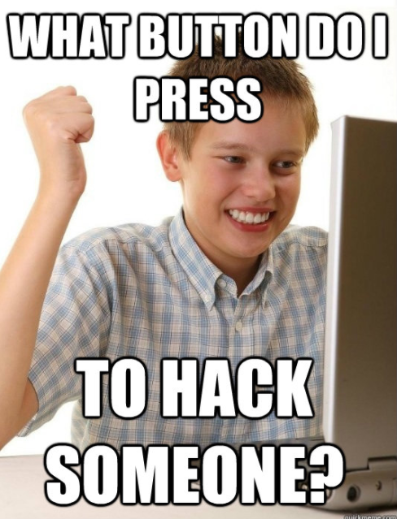
Internal Networks
The ‘walk’ can be and is often short
Top 5 Ways I Compromise:
Responder
Local Admin Reuse
Overly Permissive Group’s
Default Creds
GPP

Slide 43
Internal Networks
The ‘walk’ can be and is often short
Top 5 Ways I Compromise:
Responder
Local Admin Reuse
Overly Permissive Group’s
Default Creds
GPP

Slide 44
Attacking The Network
Responder
Bob
Alice
Desktop2
SqlAdmins
Desktop1
John
Joe
Mary
DA Steve
SQLServer
WebServer

Slide 45

Attacking The Network
Bobs Creds are Compromised
Attacker VPN’s into the network.
Bob
Alice
AttackBox
Desktop2
SqlAdmins
John
Desktop1
Joe
Mary
DA Steve
SQLServer
WebServer

Slide 46
Attacking The Network
I’m Whoever you want me to be!
Attacker Listens on the network when Mary makes a Request
Bob
Alice
Desktop2
AttackBox
Who knows the IP for \\myfiles.com
SqlAdmins
John
Desktop1
Joe
Mary
DA Steve
Session on
SQLServer
WebServer

Slide 47
Attacking The Network
Mary sends credentials to the attacker for the File
Bob
Alice
Desktop2
AttackBox
SqlAdmins
John
Member of
Desktop1
Sends Creds to Access File
Can Access
Joe
Mary
DA Steve
Can Access
Session on
SQLServer
WebServer

Slide 48
Attacking The Network
Attacker Can Modify and Relay the request to the SQLServer
Bob
Alice
Desktop2
AttackBox
SqlAdmins
John
Relay’s Credentials to the SQL Server
Member of
Desktop1
Sends Creds to Access File
Can Access
Joe
Mary
DA Steve
Can Access
Session on
SQLServer
WebServer

Slide 49
Attacking The Network
Now the DA is Compromised
Bob
Alice
Desktop2
AttackBox
SqlAdmins
John
Relay’s Credentials to the SQL Server
Member of
Desktop1
Sends Creds to Access File
Can Access
Joe
Mary
DA Steve
Can Access
Session on
SQLServer
WebServer

Slide 50
Internal Networks
The ‘walk’ can be and is often short
Top 5 Ways I Compromise:
Responder Fix = Disable LLMNR & NBT-NS
Local Admin Reuse
Overly Permissive Group’s
Default Creds
GPP

Slide 51
Internal Networks
The ‘walk’ can be and is often short
Top 5 Ways I Compromise:
Responder
Local Admin Reuse
Overly Permissive Group’s
Default Creds
GPP

Slide 52
Attacking The Network
Local Admin
Bob
Can Access
Alice
Can Access
Desktop2
SqlAdmins
Desktop1
John
Joe
Mary
DA Steve
SQLServer
WebServer

Slide 53
Attacking The Network
Local Admin Everywhere
Bob
Can Access
Alice
Can Access
Desktop2
SqlAdmins
Desktop1
John
Joe
Mary
DA Steve
SQLServer
WebServer

Slide 54
Attacking The Network
Local Admin Everywhere
Bob
Can Access
Alice
Can Access
Desktop2
SqlAdmins
Desktop1
John
Joe
Mary
DA Steve
SQLServer
WebServer

Slide 55
Internal Networks
The ‘walk’ can be and is often short
Top 5 Ways I Compromise:
Responder
Local Admin Reuse Fix = LAPS
Overly Permissive Group’s
Default Creds
GPP

Slide 56
Internal Networks
The ‘walk’ can be and is often short
Top 5 Ways I Compromise:
Responder
Local Admin Reuse
Overly Permissive Group’s
Default Creds
GPP

Slide 57
Attacking The Network
Nested and Inherited Groups
Privileged Account Groups
Enterprise Admins | Account Operators
Domain Admins | Backup Operators
Schema Admin | Print Operators
BUILTIN\Administrators | Server Operators
Domain Controllers | Group Policy Creators Owners
Read-only Domain Controllers | Cryptographic Operators
https://technet.microsoft.com/en-us/library/dn579255(v=ws.11).aspx#BKMK_Admins
Notes:
These are just defaults

Slide 58

Attacking The Network
BloodHound is developed by @_wald0, @CptJesus, and @harmj0y.
Notes:
“BloodHound is a single page Javascript web application, built on top of Linkurious, compiled with Electron, with a Neo4j database fed by a PowerShell ingestor C# ingester.”

Slide 59
Attacking The Network
Fantastic tools for both Red and Blue teams!
Quickly identify ‘control relations’ between objects in Active Directory
Highly complex attack paths visualized in graphs

Slide 60
Attacking The Network
Fantastic tools for both Red and Blue teams!
Quickly identify ‘control relations’ between objects in Active Directory
Highly complex attack paths visualized in graphs

Slide 61
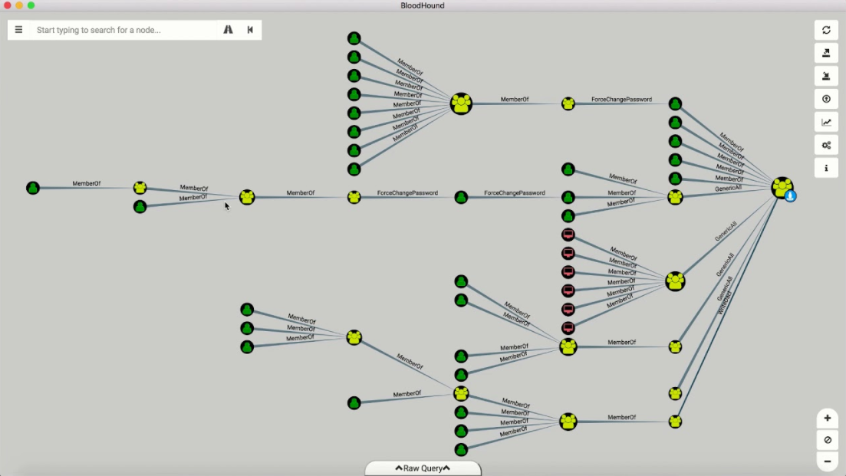
Attacking The Network
Bloodhound / Sharphound

Slide 62
Attacking The Network
Fantastic tools for both Red and Blue teams!
Quickly identify ‘control relations’ between objects in Active Directory
Highly complex attack paths visualized in graphs

Slide 63
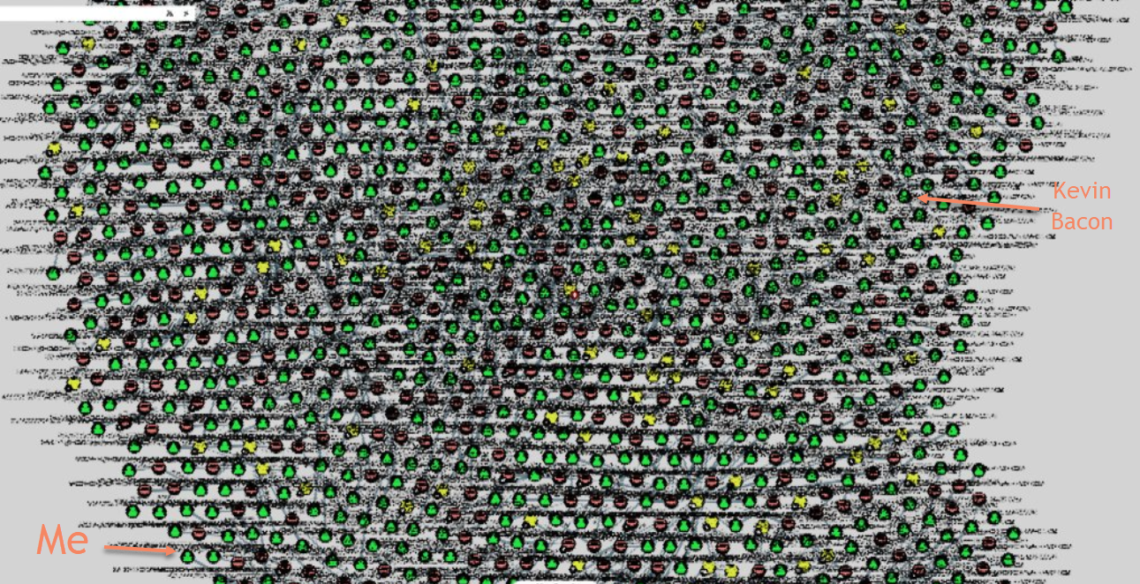
Attacking The Network
Bloodhound / Sharphound

Slide 64
Internal Networks
The ‘walk’ can be and is often short
Top 5 Ways I Compromise:
Responder
Local Admin Reuse
Overly Permissive Group’s Fix = Trim those privileged groups
Default Creds
GPP

Slide 65
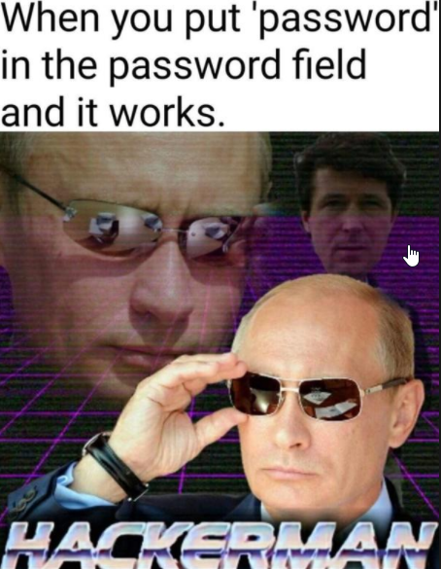
Internal Networks
The ‘walk’ can be and is often short
Top 5 Ways I Compromise:
Responder
Local Admin Reuse
Privileged Group’s
Default Creds
GPP

Slide 66
Internal Networks
The ‘walk’ can be and is often short
Top 5 Ways I Compromise:
Responder
Local Admin Reuse
Privileged Group’s
Default Creds Fix = Always change default configs
GPP

Slide 67
Internal Networks
The ‘walk’ can be and is often short
Top 5 Ways I Compromise:
Responder
Local Admin Reuse
Privileged Group’s
Default Creds
GPP

Slide 68
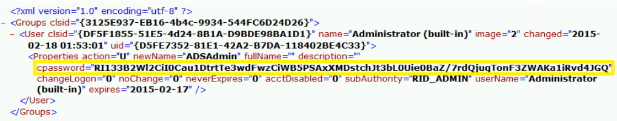
Internal Networks
The ‘walk’ can be and is often short
Group Policy Preference Files

Slide 69
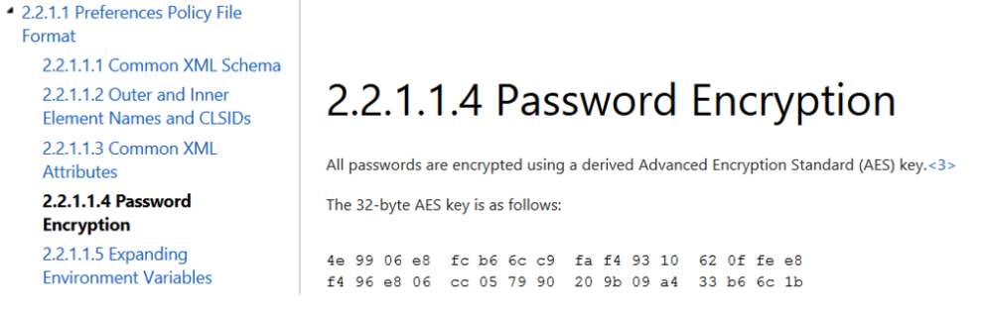
Internal Networks
The ‘walk’ can be and is often short
https://msdn.microsoft.com/en-us/library/2c15cbf0-f086-4c74-8b70-1f2fa45dd4be.aspx

Slide 70
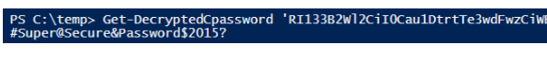
Internal Networks
The ‘walk’ can be and is often short
https://github.com/PowerShellMafia/PowerSploit/blob/master/Exfiltration/Get-GPPPassword.ps1

Slide 71
Internal Networks
The ‘walk’ can be and is often short
Top 5 Ways I Compromise:
Responder
Local Admin Reuse
Privileged Group’s
Default Creds
GPP Fix= MS14-025, KB943729

Slide 72
Case Review
Typical Attack Path
theHarvester/Breaches/public sources
*From the External Assessment

Slide 73
Case Review
Typical Attack Path
theHarvester/Breaches/public sources
Use Burpsuite for a password brute force against Citrix server
*From the External Assessment

Slide 74
Case Review
Typical Attack Path
theHarvester/Breaches/public sources
Use Burpsuite for a password brute force against Citrix server
Citrix escape: Launch Word, use Open File and browse to cmd.exe then launch.
*From the External Assessment

Slide 75
Case Review
Typical Attack Path
theHarvester/Breaches/public sources
Use Burpsuite for a password brute force against Citrix server
Citrix escape: Launch Word, use Open File and browse to cmd.exe then launch.
Generate reverse Powershell Empire payload and execute
*From the External Assessment

Slide 76
Case Review
Typical Attack Path
theHarvester/Breaches/public sources
Use Burpsuite for a password brute force against Citrix server
Citrix escape: Launch Word, use Open File and browse to cmd.exe then launch.
Generate reverse Powershell Empire payload and execute
Query for domain admins
Query for domain controllers
Find Local Admin access
*From the External Assessment

Slide 77
Case Review
Typical Attack Path
theHarvester/Breaches/public sources
Use Burpsuite for a password brute force against Citrix server
Citrix escape: Launch Word, use Open File and browse to cmd.exe then launch.
Generate reverse Powershell Empire payload and execute
Query for domain admins
Query for domain controllers
Find Local Admin access
Run Bloodhound
*From the External Assessment

Slide 78
Case Review
Typical Attack Path
theHarvester/Breaches/public sources
Use Burpsuite for a password brute force against Citrix server
Citrix escape: Launch Word, use Open File and browse to cmd.exe then launch.
Generate reverse Powershell Empire payload and execute
Query for domain admins
Query for domain controllers
Find Local Admin access
Run Bloodhound
Find attack paths
*From the External Assessment

Slide 79
Case Review
Typical Attack Path
theHarvester/Breaches/public sources
Use Burpsuite for a password brute force against Citrix server
Citrix escape: Launch Word, use Open File and browse to cmd.exe then launch.
Generate reverse Powershell Empire payload and execute
Query for domain admins
Query for domain controllers
Find Local Admin access
Run Bloodhound
Find attack paths
Mimikatz on Local Admin machines
*From the External Assessment

Slide 80
Case Review
Typical Attack Path
theHarvester/Breaches/public sources
Use Burpsuite for a password brute force against Citrix server
Citrix escape: Launch Word, use Open File and browse to cmd.exe then launch.
Generate reverse Powershell Empire payload and execute
Query for domain admins
Query for domain controllers
Find Local Admin access
Run Bloodhound
Find attack paths
Mimikatz on Local Admin machines
Get new creds
Find new Local Admin access
*From the External Assessment

Slide 81
Case Review
Typical Attack Path
theHarvester/Breaches/public sources
Use Burpsuite for a password brute force against Citrix server
Citrix escape: Launch Word, use Open File and browse to cmd.exe then launch.
Generate reverse Powershell Empire payload and execute
Query for domain admins
Query for domain controllers
Find Local Admin access
Run Bloodhound
Find attack paths
Mimikatz on Local Admin machines
Get new creds
Find new Local Admin access
Mimikatz again
*From the External Assessment

Slide 82
Case Review
Typical Attack Path
theHarvester/Breaches/public sources
Use Burpsuite for a password brute force against Citrix server
Citrix escape: Launch Word, use Open File and browse to cmd.exe then launch.
Generate reverse Powershell Empire payload and execute
Query for domain admins
Query for domain controllers
Find Local Admin access
Run Bloodhound
Find attack paths
Mimikatz on Local Admin machines
Get new creds
Find new Local Admin access
Mimikatz again
Repeat until a path to DA opens up.
*From the External Assessment

Slide 83
Case Review
Typical Attack Path
theHarvester/Breaches/public sources
Use Burpsuite for a password brute force against Citrix server
Citrix escape: Launch Word, use Open File and browse to cmd.exe then launch.
Generate reverse Powershell Empire payload and execute
Query for domain admins
Query for domain controllers
Find Local Admin access
Run Bloodhound
Find attack paths
Mimikatz on Local Admin machines
Get new creds
Find new Local Admin access
Mimikatz again
Repeat until a path to DA opens up.
DCSync with D.A. creds
*From the External Assessment

Slide 84
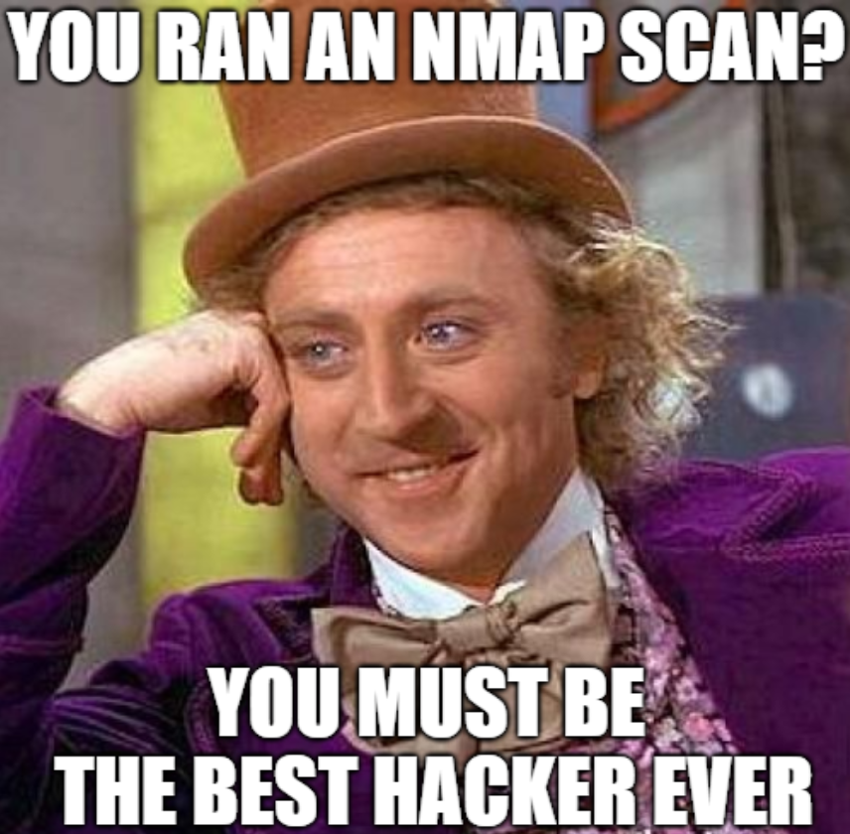
Pentest vs Scanning
If you had an internal pentest and they didn’t compromise you….
Come talk to me.

Slide 85
Closing Remarks
Check out the Depth CTF on the main stage
About Me:
Ryan Preston @awsmhacks
My slide decks and other awsm hacks at https://github.com/awsmhacks

Slide 86
If there’s a way in, we’ll find it.
Ryan Preston
@AWSMHACKS

